Slide 1
DemoSat: Machine Learning
Flight Readiness Review
Arian Rasoli
11.4.25

Slide 2

Mission Overview

Slide 3
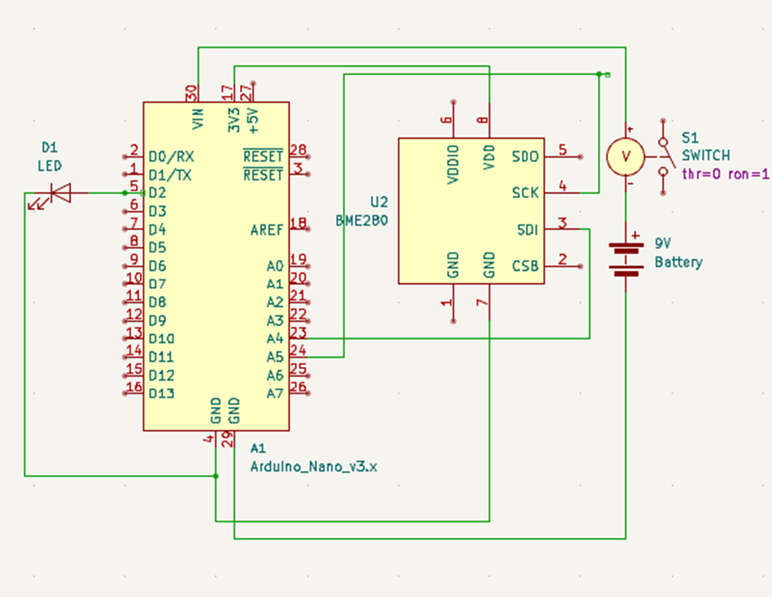
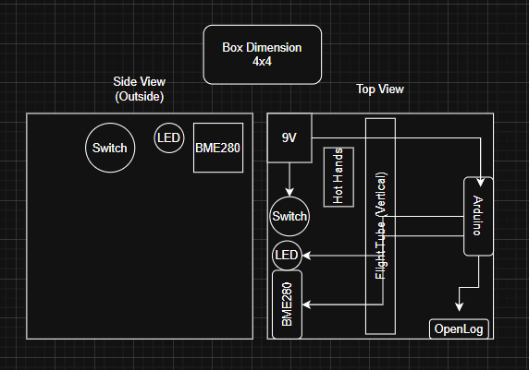
Design Overview: Hardware

Slide 4
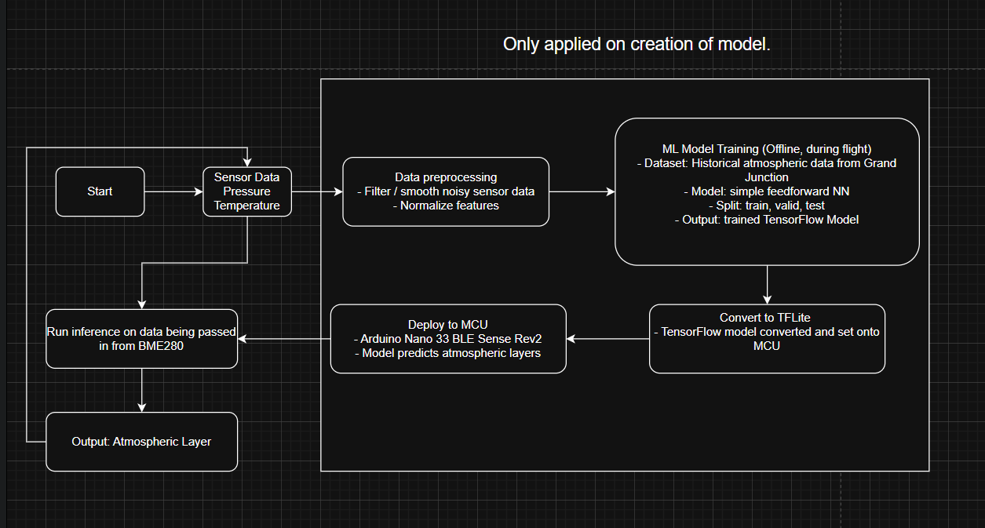
Design Overview: Software

Slide 5
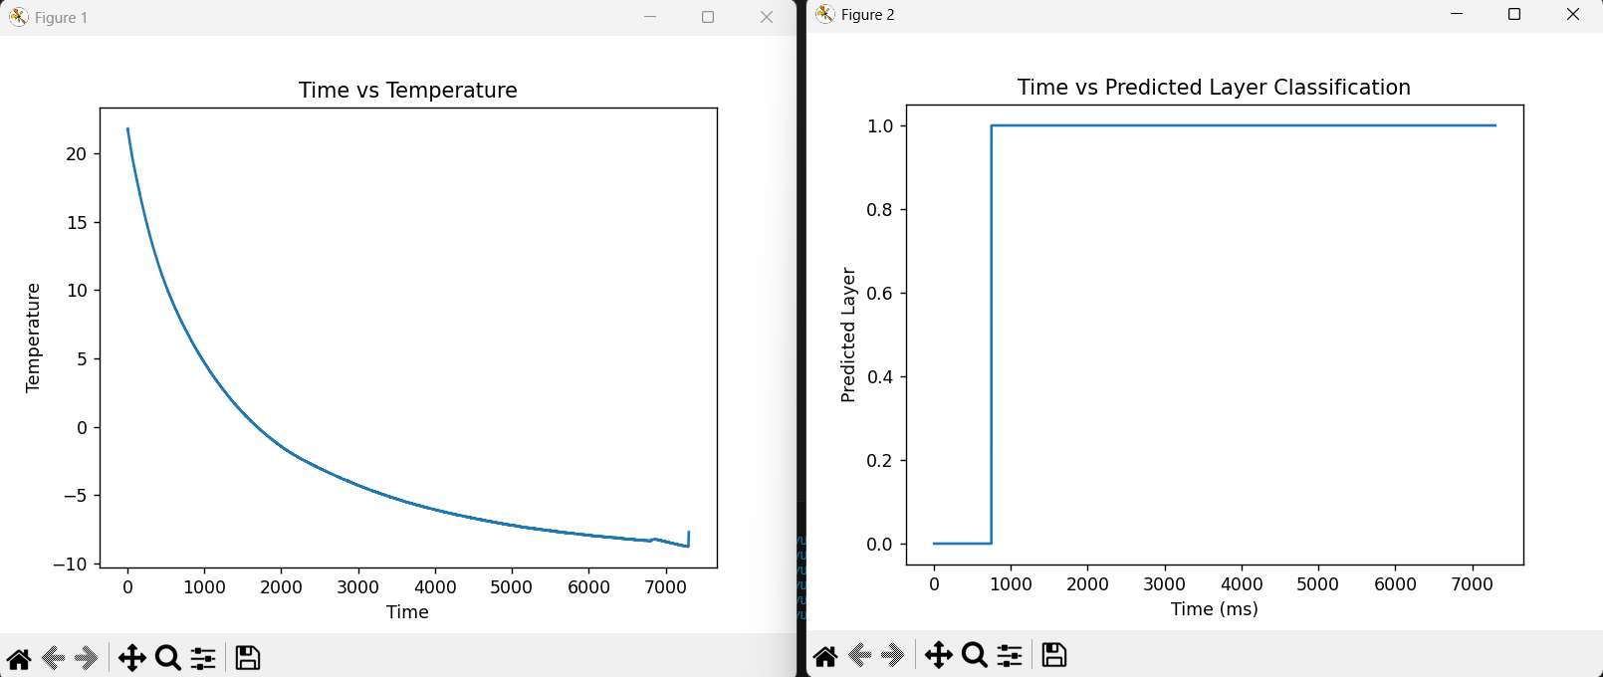
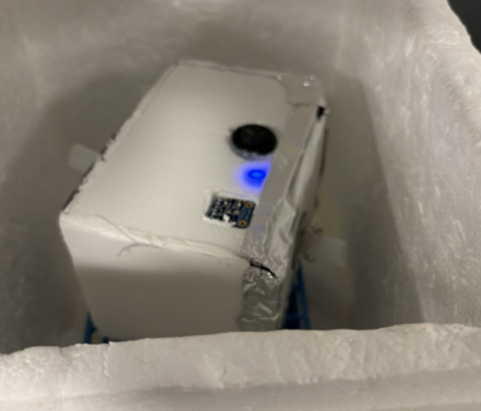
Test Results: Cold Test
- The cold test was performed on, 10/31/2025, and stayed on during the duration of the test.
The developed payload withstood temperatures of up to –10 C, however, this isn't the ideal temperature as the flight conditions can drop down to –60 C during the November 8th flight.
I intend to do a cold test again on 11/7/2025.

Slide 6
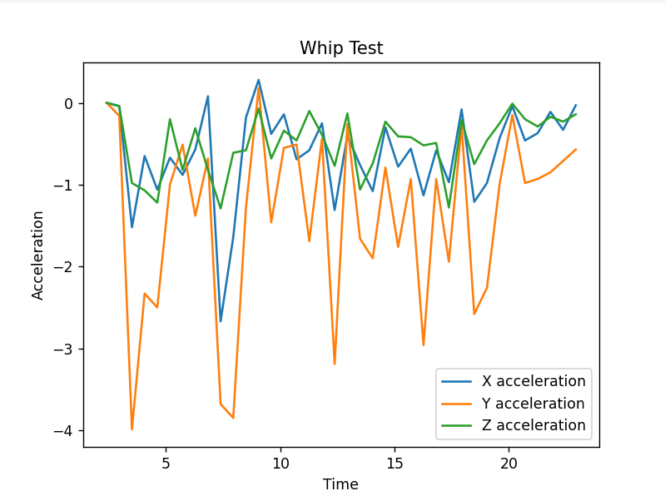
Test Results: Bench Test
- The bench test was performed on 10/31/2025 and successfully demonstrated that all systems were functioning as intended.
- This also ensures that the components inside the payload are properly secured
  Minimizing the impact of environmental factors, such as turbulence, in the event of a loose connection.

Slide 7
Predicted Data
The BME280 sensor will accurately gather temperature and pressure data throughout the flight, with all readings stored inside of an OpenLog.
The TinyML model will classify atmospheric layers in real time, with predictions aligning with expected altitude-pressure profiles.
The embedded system will run continuously without crashes or inference issues, and all components will remain powered and stable under extreme flight conditions.
Logged data will be recoverable post-flight from a stored microSD card for future analysis and validation against reference atmospheric models.

Slide 8
What’s Left?
Material/ Component​ | Integrated (Y/N)​ | Weight (g)​
​Arduino Nano 33 BLE Sense Rev2 | ​Y | 8.00​
​BME280 | ​Y | ​2.24
​9V battery | ​Y | 51
​Box, Wires, LEDS, Aluminum Tape | ​Y | ​80
OpenLog | Y | 5.00
Hand warmers (1) |  | 32
​ | Total=​ | 178.24

Slide 9
Cost Summary
Material/ Component​ | ​Quantity | Source | Cost ($)
Arduino Nano 33 BLE Sense Rev2 | 1 | Arduino | 49.97
​ | ​ | Total= | 49.97

Slide 10
Acknowledgements
Professor Jones
Professor Wikowsky
Colorado Space Grant Consortium

